Slide 1

Algorithm & Data Structure
Week 1

Slide 2
Topics
Introduction

Slide 3
The lecturer
Name: Imam Fahrur Rozi (Imam)
Phone : 085233139738 (WA enabled)
Email : imam.rozi@polinema.ac.id
Address : Gajayana Inside B9, Jl. Joyosuko Timur, Dinoyo
Office : Civil Engineering and Information Technology Building, 6th floor, Study Program Administration Room
Education :
Bachelor Degree → Electrical Engineering of Brawijaya Univ.
Master Degree → Electrical Engineering of Brawijaya Univ.
Research :
Machine Learning
Data Mining
Text Mining
Family :
The father of 3 girls (2 are kids and 1 is baby ☺)

Slide 4
Learning Strategies
Be On time
Be quite and focus in class/lab while lecturer presenting
Highly recommended to ask or perform a discussion, at any time, any place ☺
Make a note only to those that are not on the slide/jobsheet
Be Positive thinking, you will be able to master this course ☺
Highly recommended to perform a study group
Be active at https://lmsslc.polinema.ac.id/
Open your camera at the beginning and end of each meeting session or at anytime the lecturer ask you to activate your camera
If there is any further problem on connection, electricity etc, immediately confirm to the lecturer
Once you are having any problem, immediately discuss with your lecturer, academic supervisor or head of study program

Slide 5
Topics
Lesson :
Week 1. Object
Week 2. Array of Object
Week 3. Bruteforce,devide-conquer
Week 4. Quiz
Week 5. Sorting (Bubble, selection, insertion)
Week 6. Searching(Sequential, Binary)
Week 7. Stack
Week 8. Queue.
Week 9. Middle Exam
Week 10. Linked List
Week 11. Double linked List
Week 12. Tree (Binary)
Week 13. Quiz
Week 14. Tree (Binary search tree)
Week 15. DFS, BFS
Week 16. Graph
Week 17. Final Exam
Exam:
Quiz : 15%, UTS : 30%, UAS : 35%, Tugas : 20%

Slide 6
Tools
Tools:
Java
NetBeans
Star UML

Slide 7
Basic Programming Review

Slide 8
Variable and Data Type

Slide 9
Variable
Identifier that would be used to store value of data
Anytime you need ‘a place’ to store a value of data then simply declare a variable
Variable declaration needs data type
Example:
int score;
String name;
String phoneNumber;

Slide 10
Data Type
Indicate the type of data that would be stored in a variable
Number → int, float, double, long
True/false → Boolean
Character → char
Sequence of character → String
etc

Slide 11
Operator
Character that represents an action applied to operands
Arithmatic operator → +, -, /, *
Comparison operator → >, <, ==, <=, >= (produce true-false)
Logical operator → &&, ||, ! (produce true-false)
Assignment operator → =
Etc.

Slide 12
Condition Selection

Slide 13
Selection
Selection is instruction to select process based on the condition
Condition → expression that produces true-false
TREU
FALSE
OR

Slide 14
Selection Sintax (1) if
If condition gives true (is correct) then the statements would be executed
Otherwise, the statements would be skipped
if (condition) {
statements;
}
example
if (x<0){
x++;
}

Slide 15
Selection Sintax (2) if-else
If condition gives true (is correct) then the statement 1 would be executed
Otherwise, the statement 2 would be executed
if (condition) {
statement 1;
} else{
statement 2;
}
example
if (x<0){
x++;
}else{
x--;
}

Slide 16
Selection Sintax (3) if-else if-else
If condition 1 is true then the statement 1 would be executed
Otherwise, then condition 2 is checked and if it is true then statement 2 would be executed
Otherwise, then statement 3 is executed
if (condition 1) {
statement 1;
} else if (condition 2){
statement 2;
}else{
statement 3;
}
if (x<0) {
System.out.println (“negative”);
} else if (x>0){
System.out.println (“positive”);
}else{
System.out.println (“zero”);
}

Slide 17
Selection Sintax (4) switch-case
Switch-case works with byte, short, char, int, String data type
The switch expression is evaluated once
The value of expression is compared with the values of each case
If there is a match, then the associated statement is executed
switch (expression){
case x:
//statements break;
case y:
//statements
break;
default:
//statements
}
int day = 4;
switch (day) {
case 1: System.out.println("Monday"); break;
case 2: System.out.println("Tuesday"); break;
case 3: System.out.println("Wednesday"); break;
case 4: System.out.println("Thursday"); break;
case 5: System.out.println("Friday"); break;
case 6: System.out.println("Saturday"); break;
default: System.out.println("Sunday");
}
// Outputs "Thursday" (day 4)

Slide 18
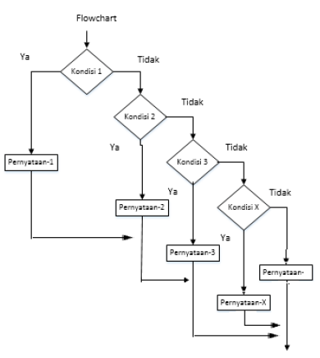
Selection Sintax (5)
Nested IF
If there is IF block inside of another IF block
if (condition 1){
if (condition 2){
statement 1;
…
…
if(condition n){ statement 2;
} else {
statement 3;
}
} else {
statement n;
}
} else {
statement x;
}

Slide 19
Looping

Slide 20
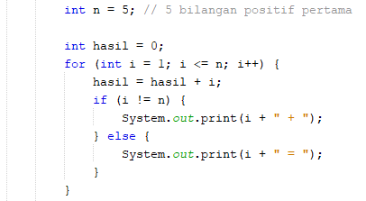
Looping Syntax (1) for
Statement 1 is executed (one time) before the execution of the code block. Usually used as initialization
Statement 2 defines the condition for executing the code block.
Statement 3 is executed (every time) after the code block has been executed. Usually known as iteration/step
for(statement1; statement2; statement3){
//code block
}

Slide 21
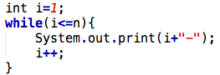
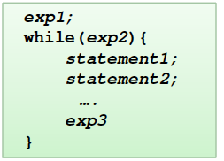
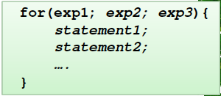
Looping Syntax (2) while
Loops can execute a block of code as long as a specified condition is reached
The while loop loops through a block of code as long as a specified condition is true:
while(condition){
//code block to be executed
}
equivalent

Slide 22
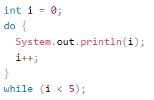
Looping Syntax (3) do-while
The do/while loop is a variant of the while loop.
This loop will execute the code block once, before checking if the condition is true, then it will repeat the loop as long as the condition is true.
do{
//code block
}while(condition);

Slide 23
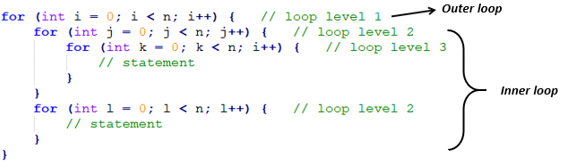
Nested Loop
Loop block that is located inside of other loop block

Slide 24
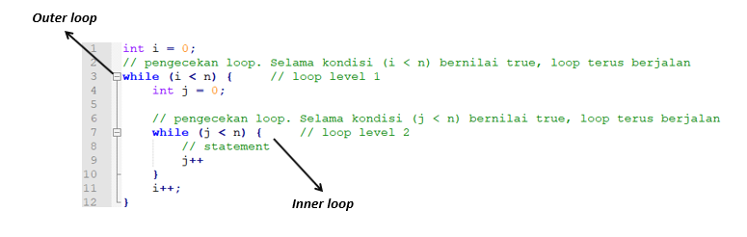
Nested Loop
Loop block that is located inside of other loop block

Slide 25
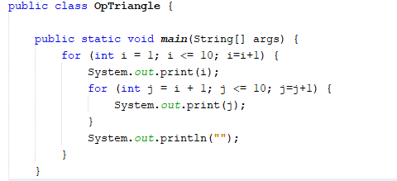
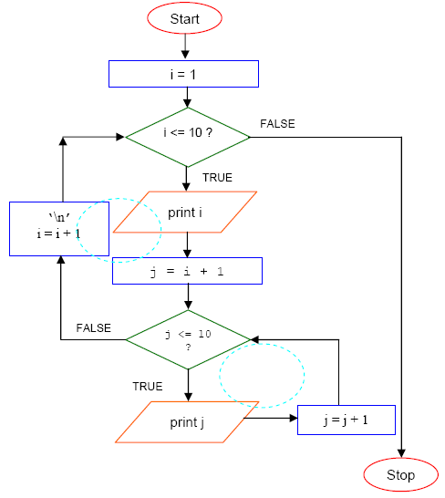
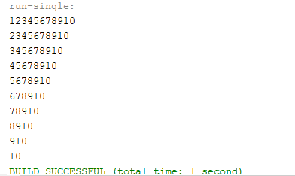
Nested Loop

Slide 26
Array

Slide 27
Array
Array is used to store multiple values in a single variable
Array can manage multiple value with same data type more effective, instead of declaring separate variables for each value
Each value in an array is identified by using index number
Index number is started by 0
data_type variable[] = new data_type[length];
example
int data[] = new int[10]
data[0] = 29;
data[1] = 34;

Slide 28
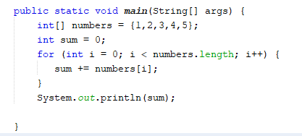
Iteration through An Array

Slide 29
Multidimmensional Array
A multidimensional array is an array containing one or more arrays.
To create a two-dimensional array, add each array within its own set of curly braces:
data_type variable[][] = new data_type[length][length];
example
int data[][] = new int[2][4];
data[0][1] = 29;
data[0][2] = 34;
data[1][0] = 23;
int[][] myNumbers = { {1, 2, 3}, {5, 6, 7} };

Slide 30
Multidimmensional Array
Rating
Movie(column)
 | 0 | 1 | 2 | 3
0 | 4 | 3 | 4 | 4
1 | 1 | 1 | 2 | 3
2 | 1 | 2 | 3 | 4
row
column
Reviewer
(row)
rating[0][2]=4
rating[1][3]=3

Slide 31
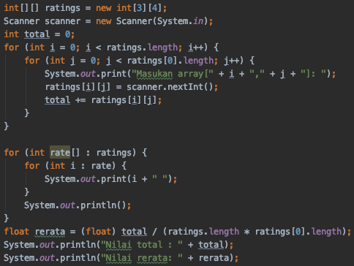
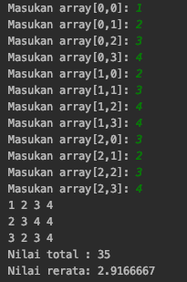
Multidimmensional Array

Slide 32
Function

Slide 33
Function
Function is a block of code that is used to perform certain action
Reuse code: define the code once, and use it many times
Also known as method
We can pass data into a function, known as parameter
Function can return a value as the end step of function
Function will be executed once it is called
static returnValueDataType functionName(dataType param1, dataType param2){
// statement
return returnValue;
}

Slide 34
static int hitungLuasPersegi(int sisi){
int luas = sisi * sisi;
return luas;
}
public static void main(String[] args){
int sisinya = 6;
int luasnya = hitungLuasPersegi(sisinya);
System.out.println(luasnya);
//atau bisa juga
System.out.println(”Luas persegi dengan sisi 5 = ”+hitungLuasPersegi(5));
}

Slide 35
Recursive Function

Slide 36
Recursive Function
Recursion is the technique of making a function call itself.
This technique provides a way to break complicated problems down into simple problems which are easier to solve.
Recursion may be a bit difficult to understand. The best way to figure out how it works is to experiment with it.

Slide 37
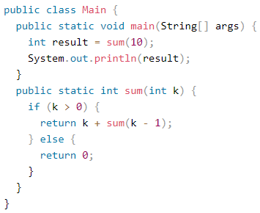
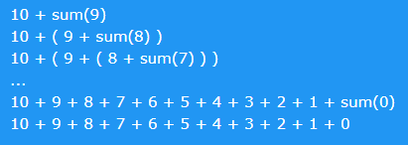
Recursive Function
Example:
Adding two numbers together is easy to do, but adding a range of numbers is more complicated. In the following example, recursion is used to add a range of numbers together by breaking it down into the simple task of adding two numbers

Slide 38
Excercise

Slide 39
Exercises
Create the flowchart of the following problems:
Display odd number sequence from 1 to 20 except number 11 and 17
Example: 1 3 5 7 9 13 15 19
Reverse the words in the array with char data type
Example word = {'S','E','L','A','M','A','T’} : output : TAMALES
Convert Seconds to Days, hours and minutes
Example : input 500000 seconds
Output : 5 days, 18 hours, 53 minutes, 20 seconds

